Slide 1
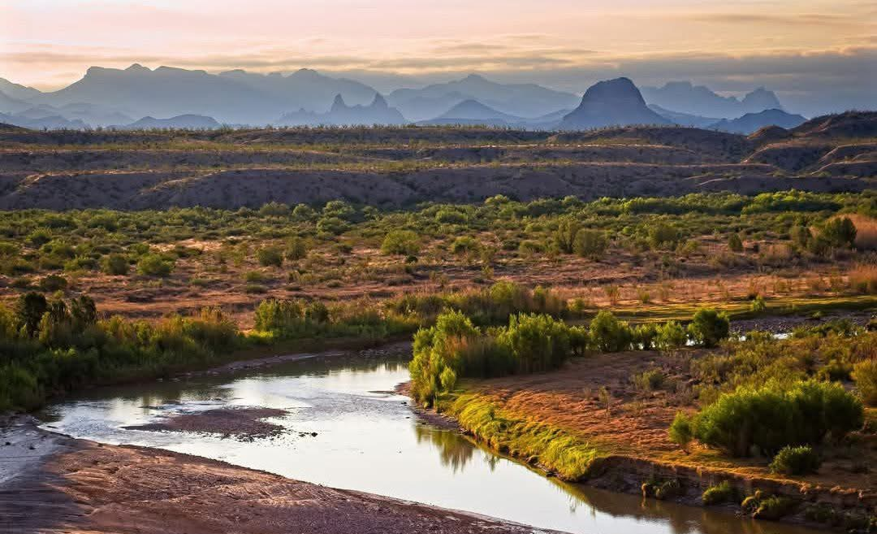
Chihuahuan Desert Education Coalition

Slide 2
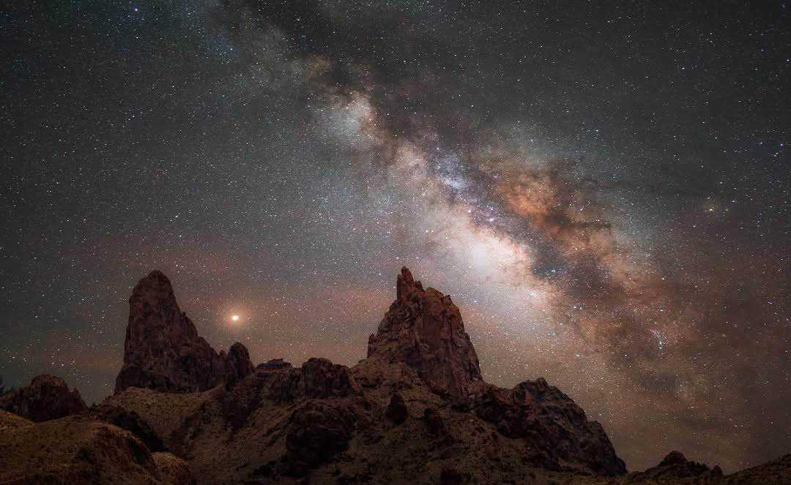
US Mexico Rio Bravo Transboundary Protected Area Conservation Initiative

Slide 3
Summary
A US Mexico International Park was first proposed by Albert William Dorgan of Castolon, Texas (now part of Big Bend National Park) in a letter to Secretary of the Interior Howard Ickes on October 8, 1932. The goal of this initiative is to put together a road map for the US and Mexico on how to best proceed in making this dream for our two nations a reality.

Slide 4
Goals
Goal 1 – develop a list of conservation advocates and elected officials from both countries who would be interested in supporting the initiative with a letter of support or their presence at a planning meeting during the Chihuahuan Desert Conference at the El Paso Zoo on November 4-6, 2026

Slide 5
Goals
Goal 2 – organize a committee of board members and others who would be interested in helping accomplish goal 1.
Goal 3 – Launch an educational outreach with a press release and presentations using the PowerPoint Presentation we are going to look at during our meeting.

Slide 6
More Information
Follow the US Mexico Park link at
https://chihuahuandesert.org/

Slide 7
Welcome
Thank you for joining us today.
If after the presentation you would like to contact us, please use the contact form at chihuahuandesert.org. Everyone will be on mute until we open up for questions.

Slide 8
Goal of the presentation – to update everyone on where we are in realizing this big dream for Texas, Mexico and the world, and to recruit people who can help put together a road map for the future. To contact us please use contact form at chihuahuandesert.org

Slide 9
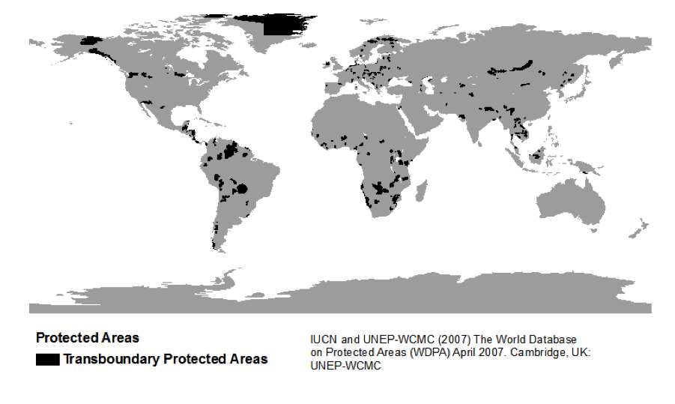

Slide 10
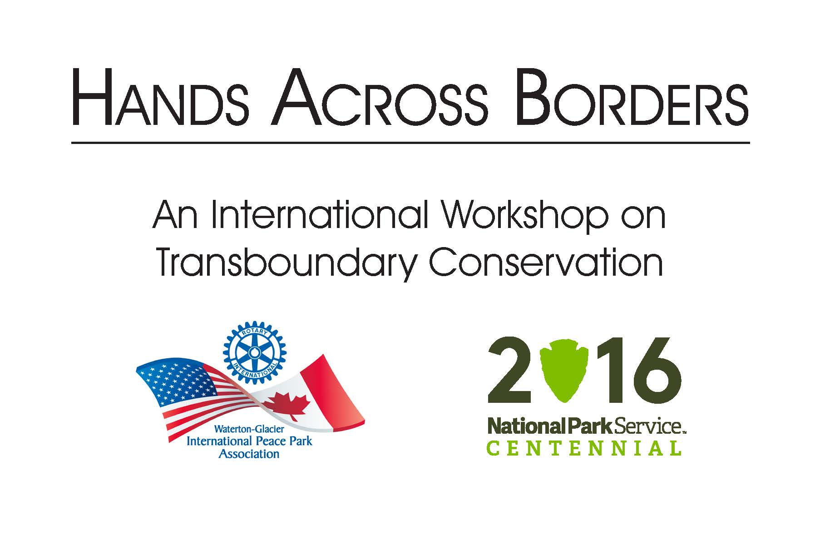

Slide 11
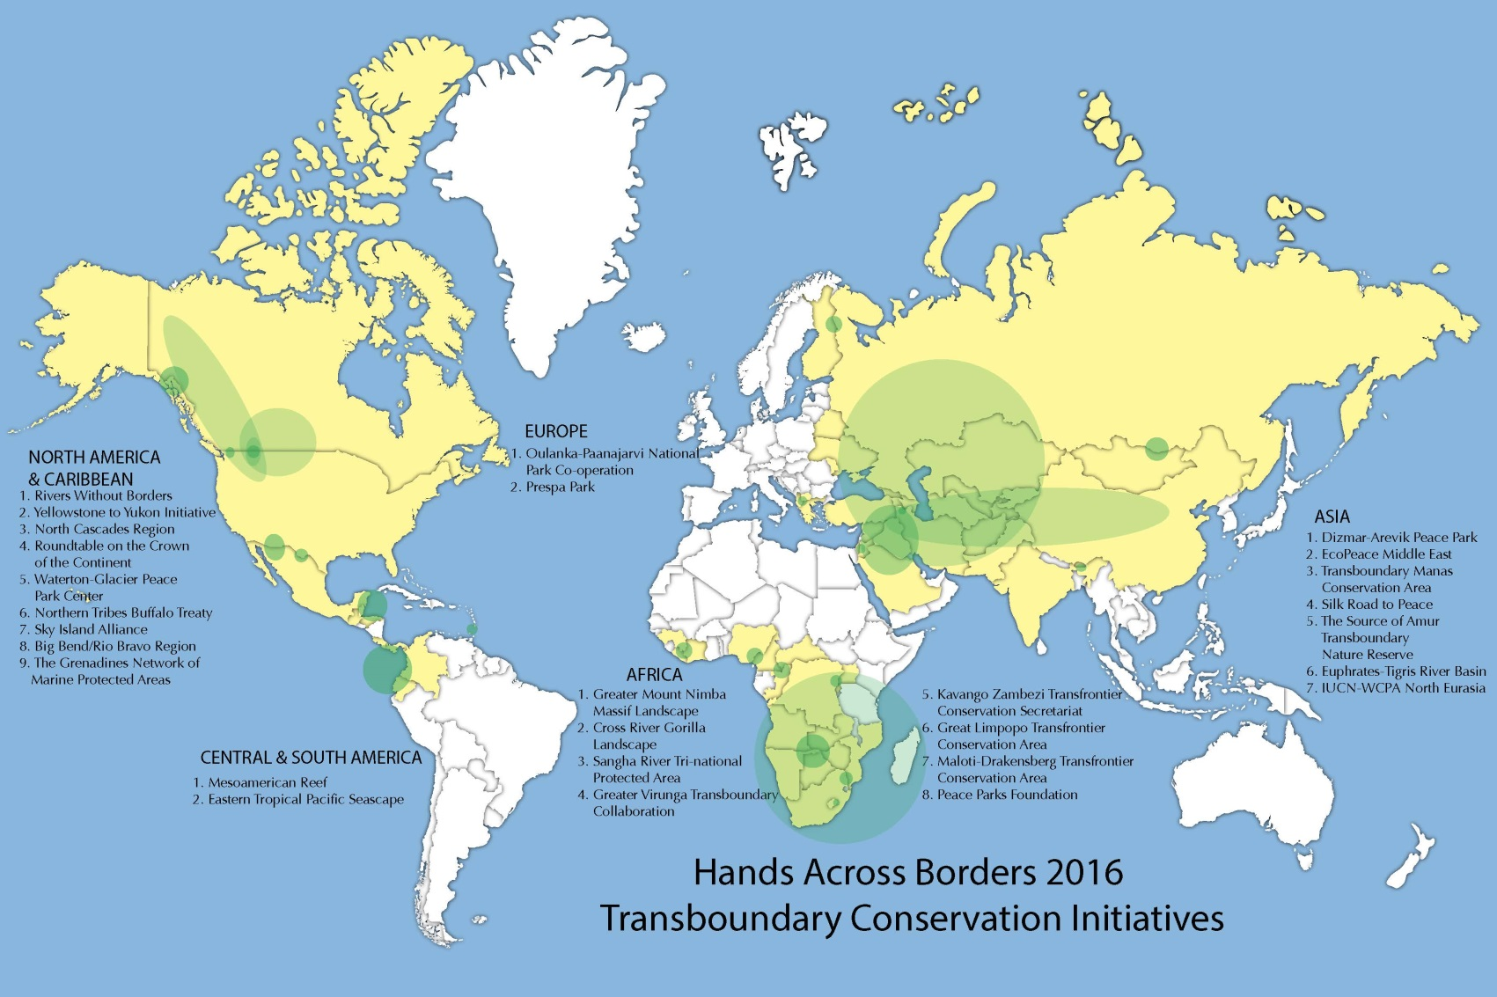

Slide 12
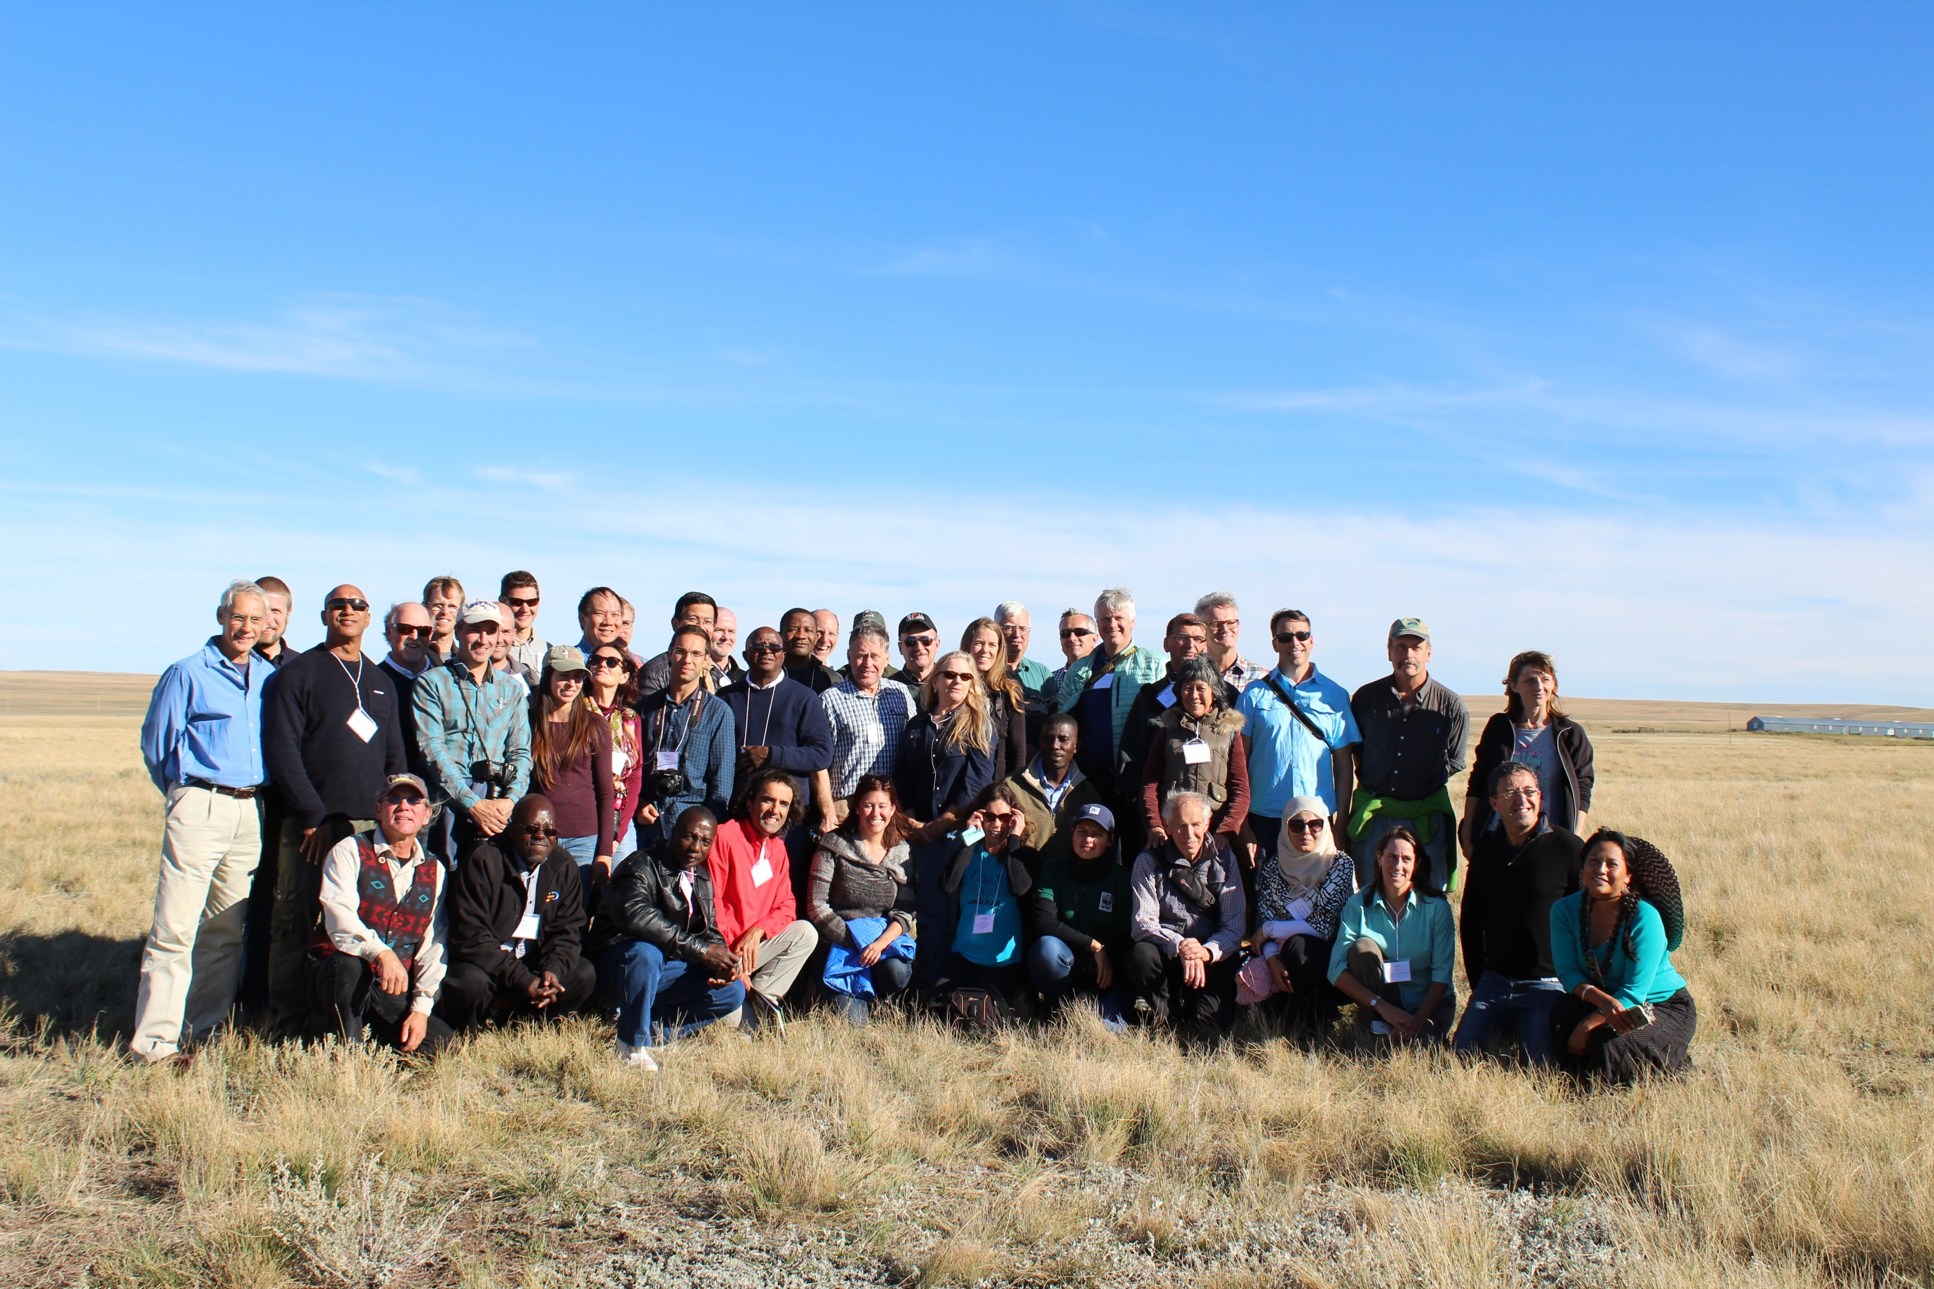

Slide 13
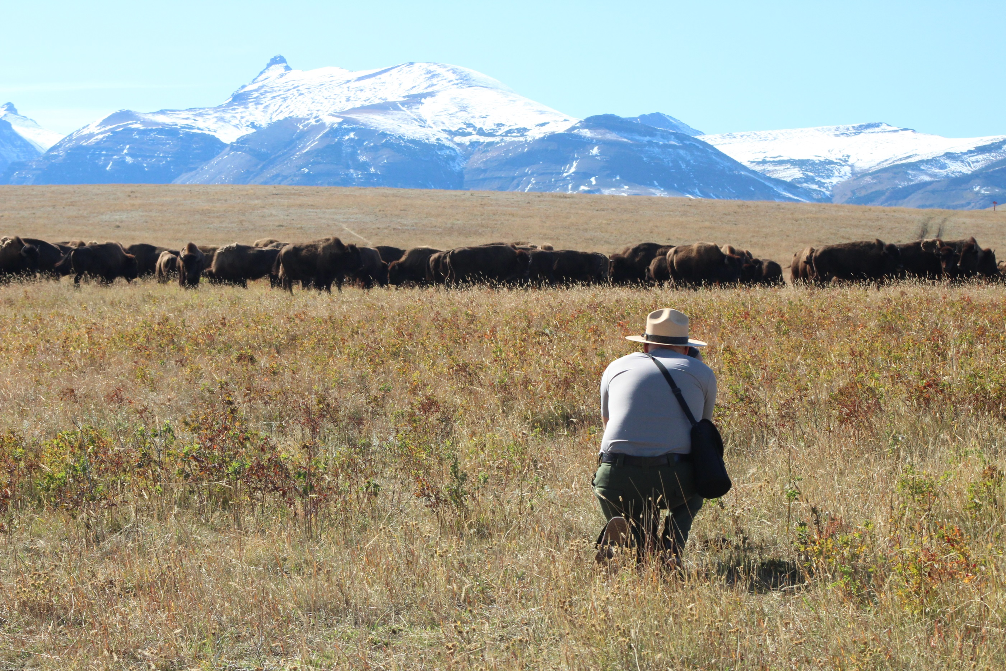

Slide 14
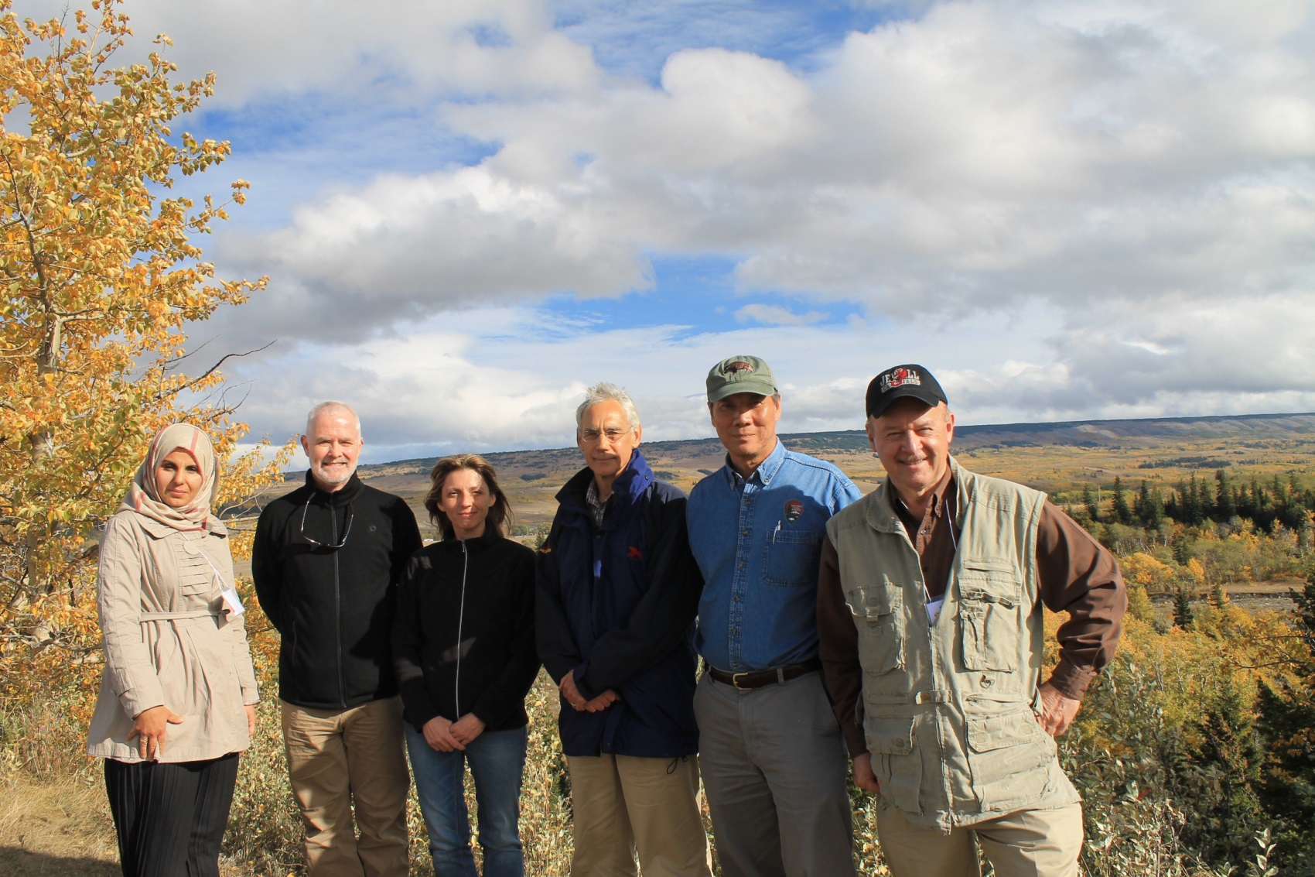

Slide 15
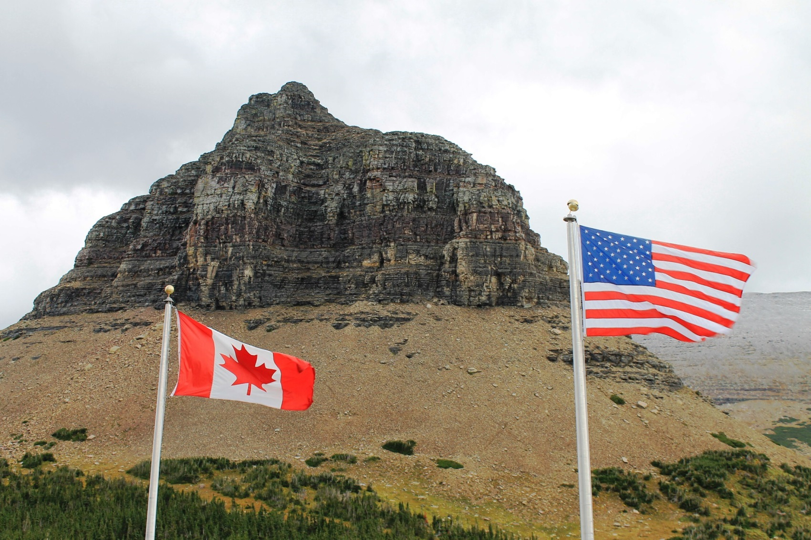

Slide 16
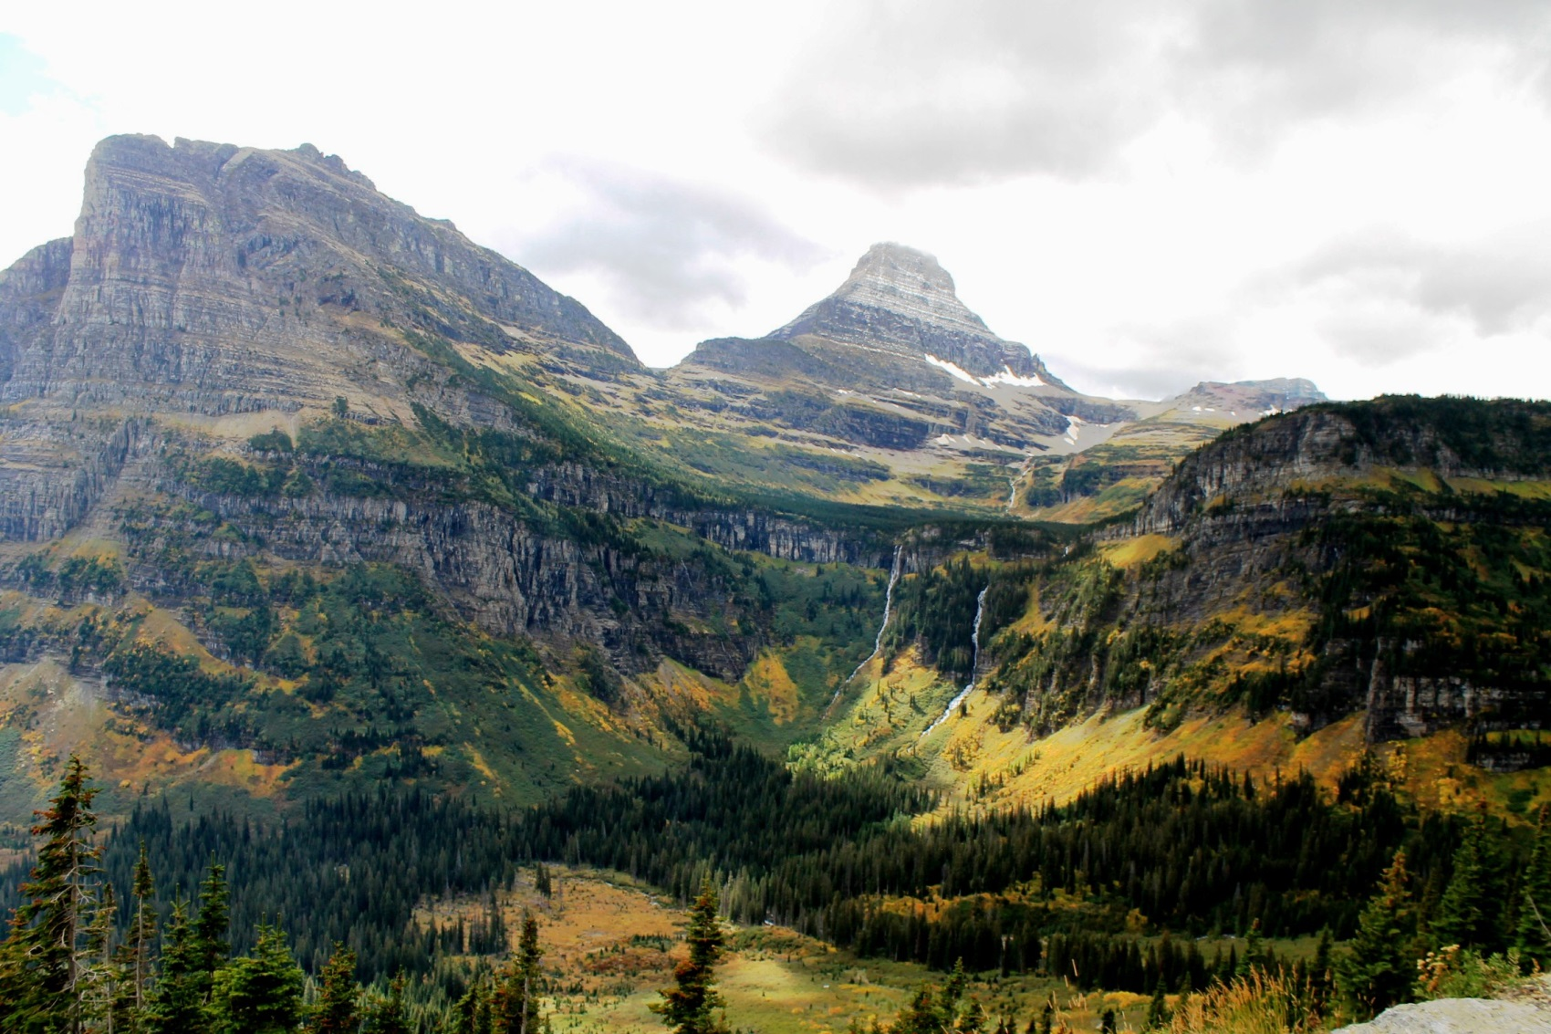

Slide 17
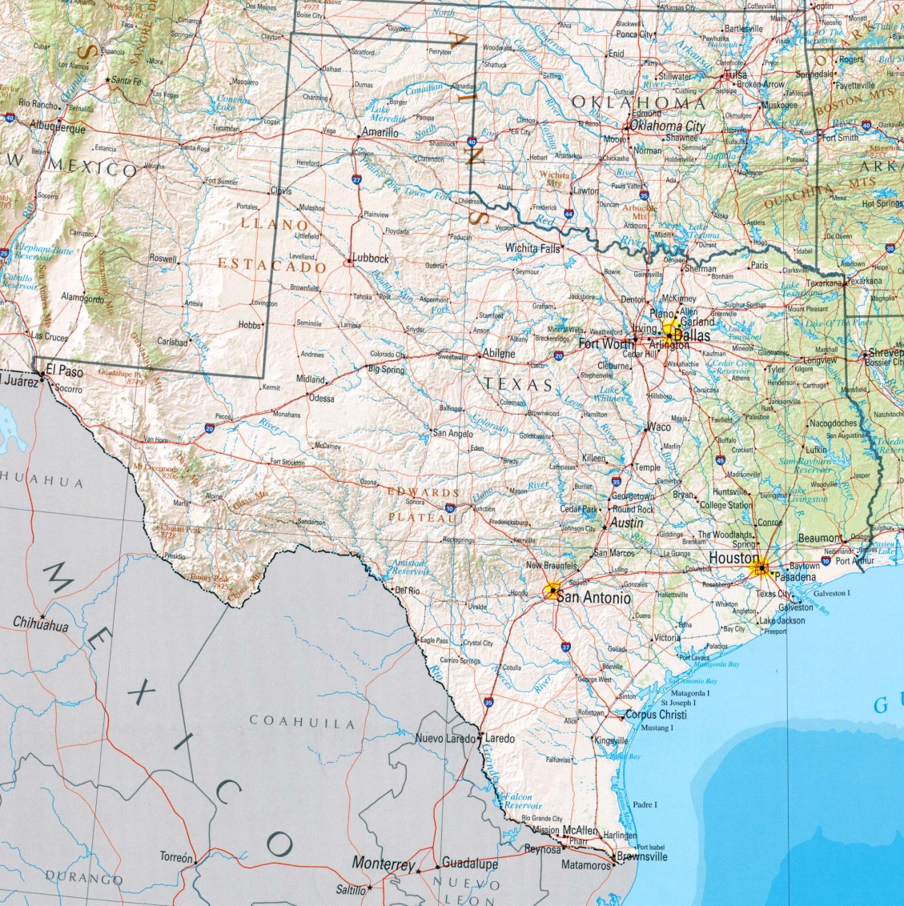

Slide 18
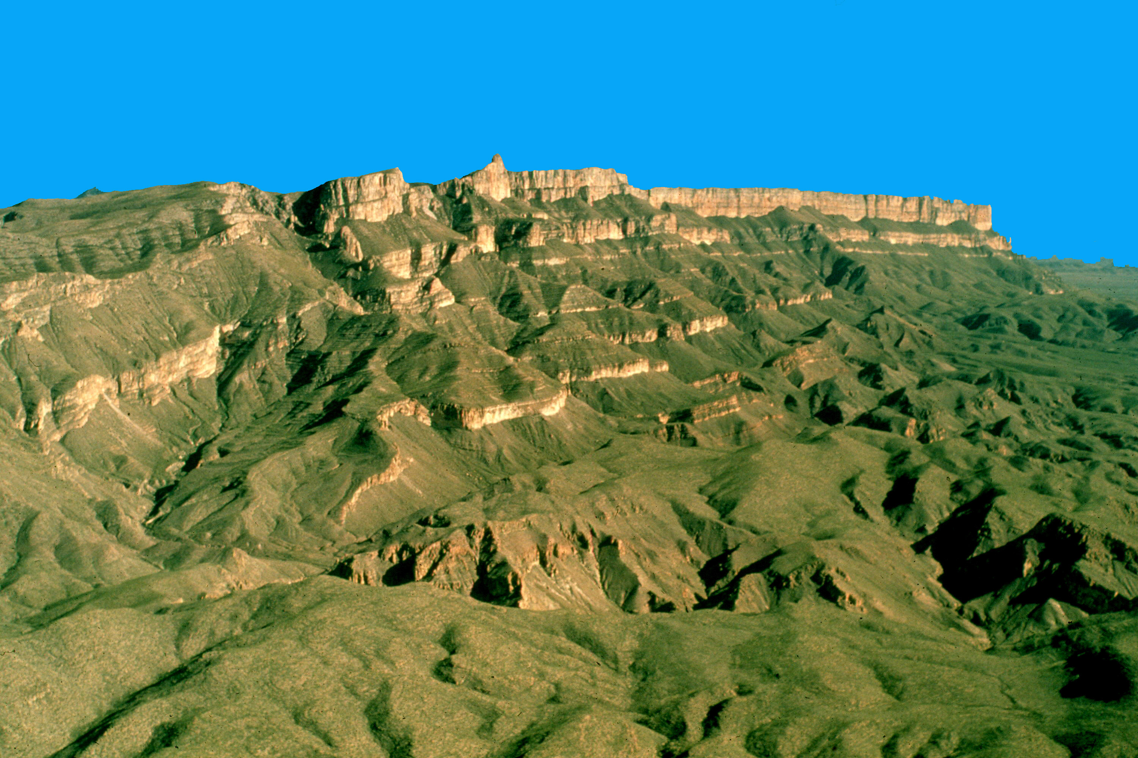

Slide 19
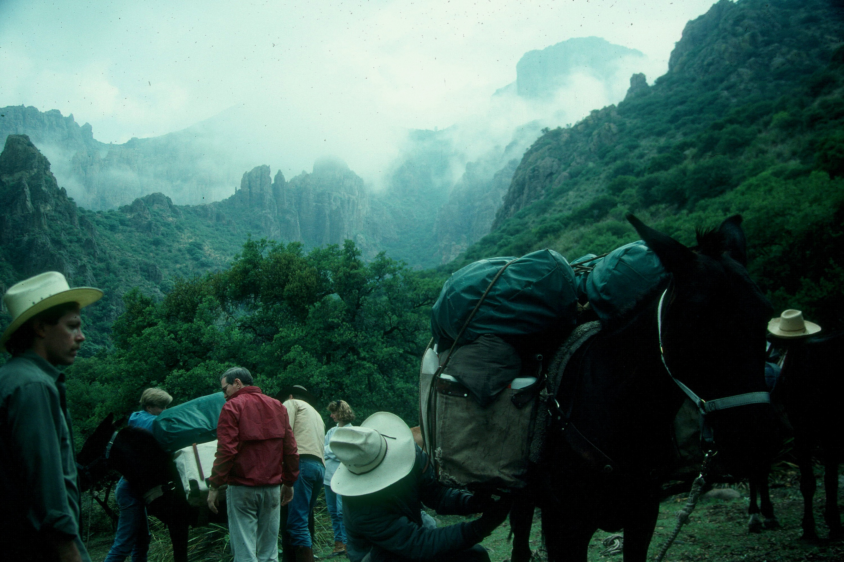

Slide 20
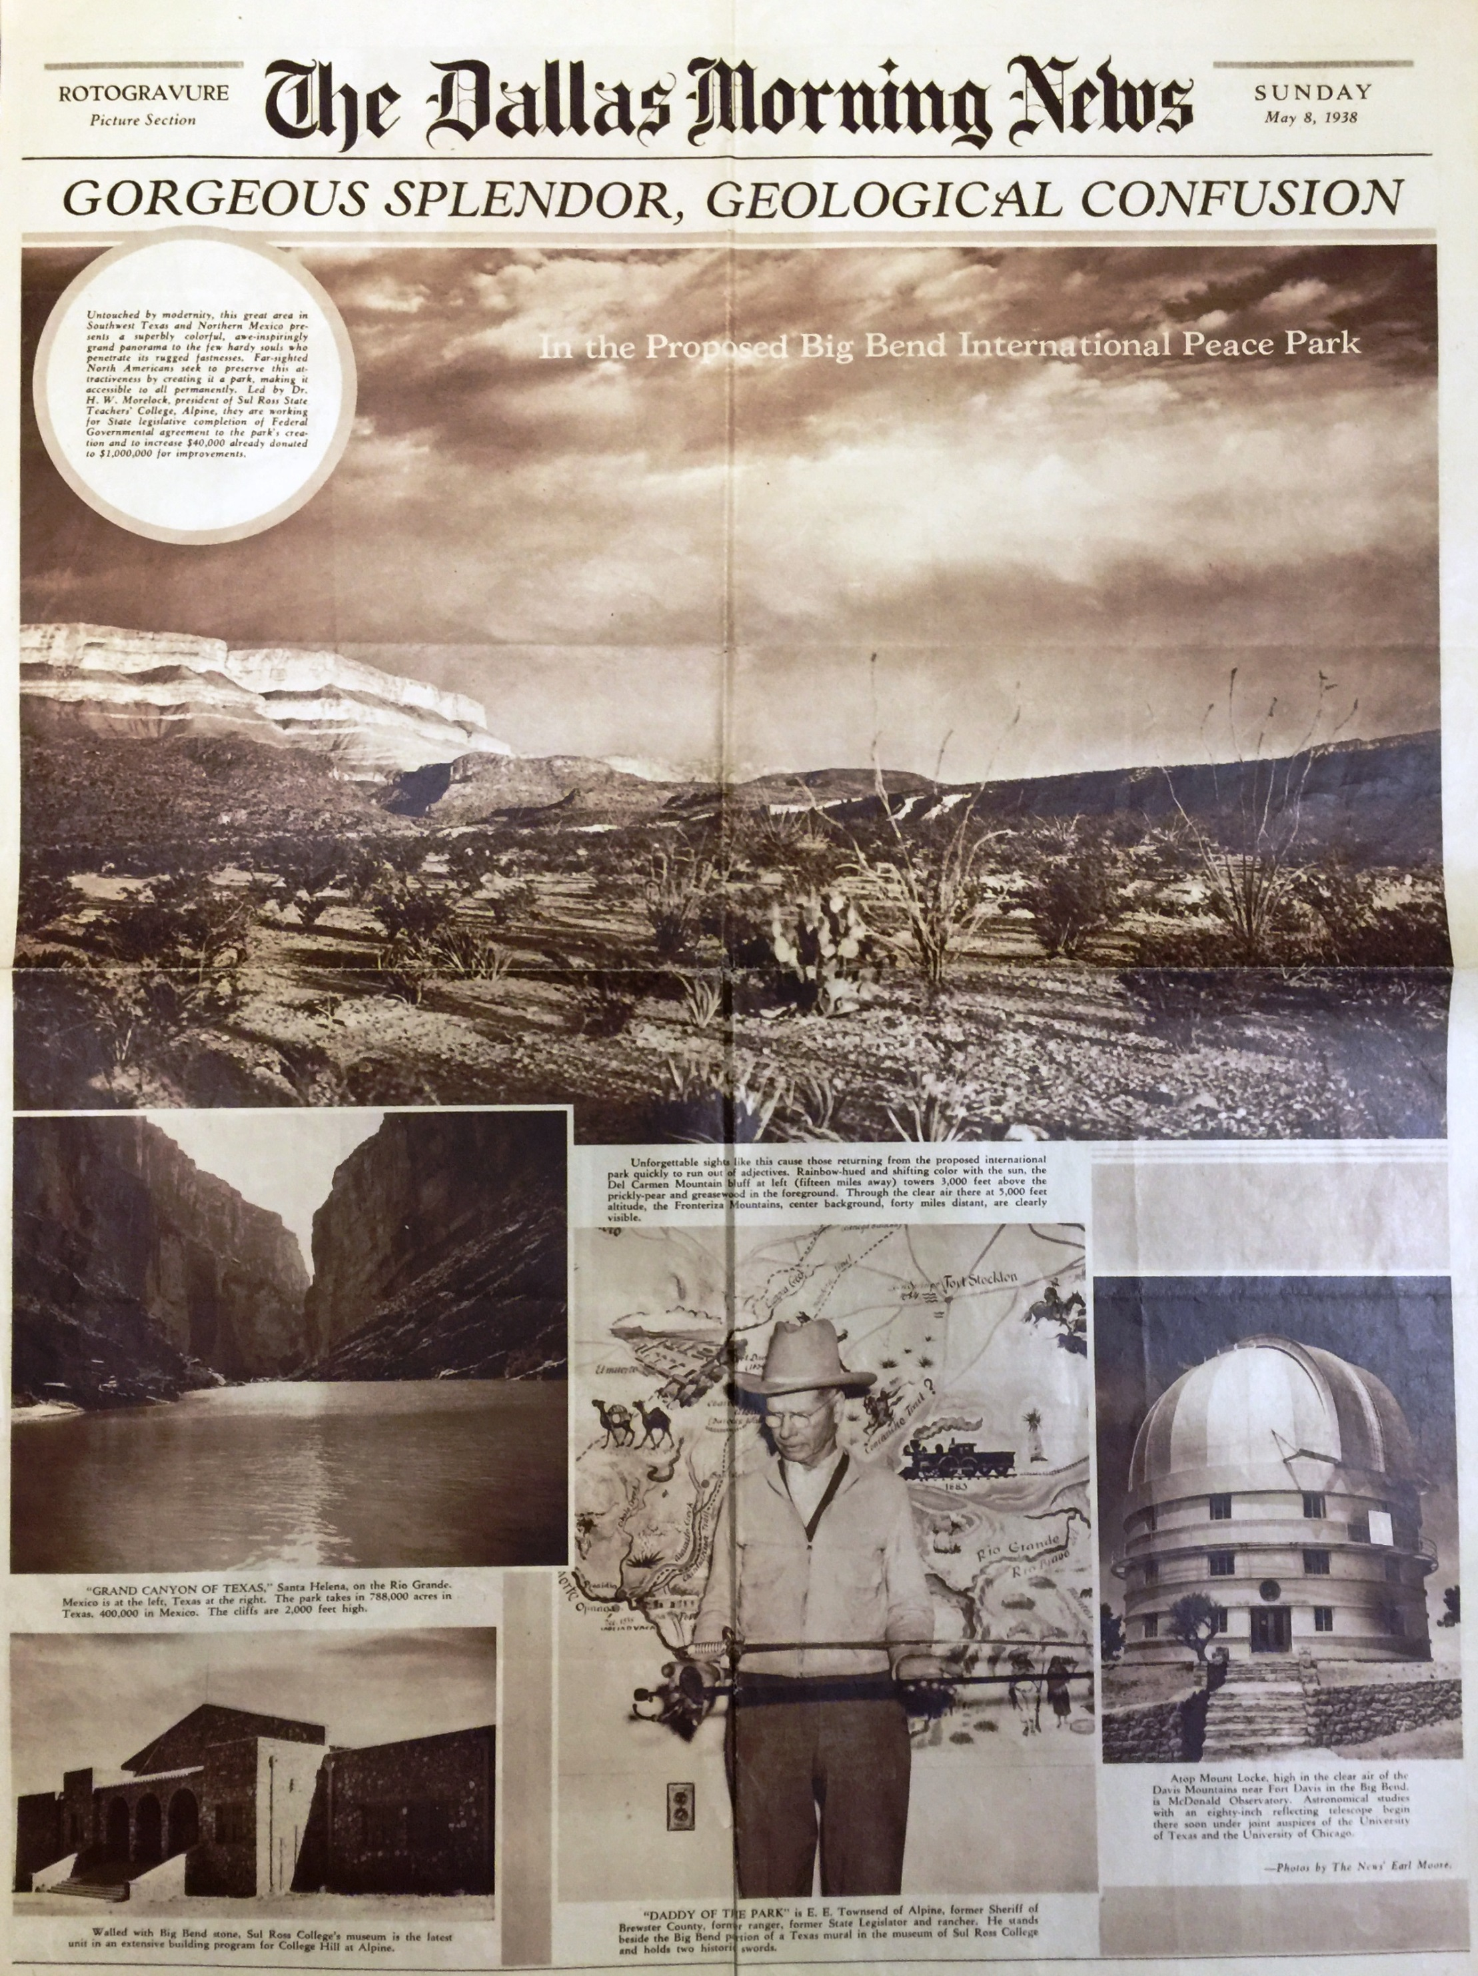

Slide 21
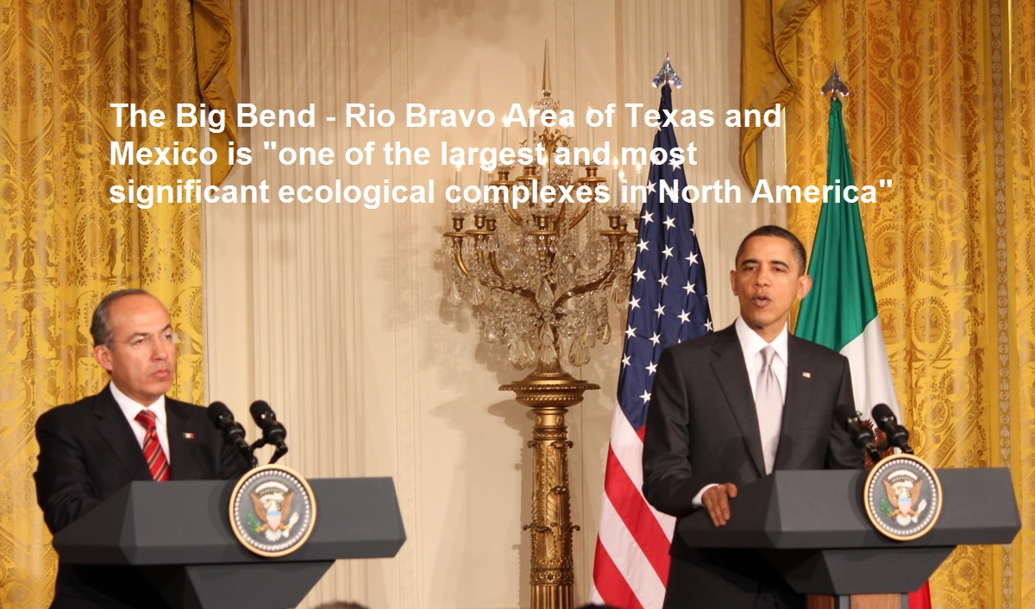

Slide 22
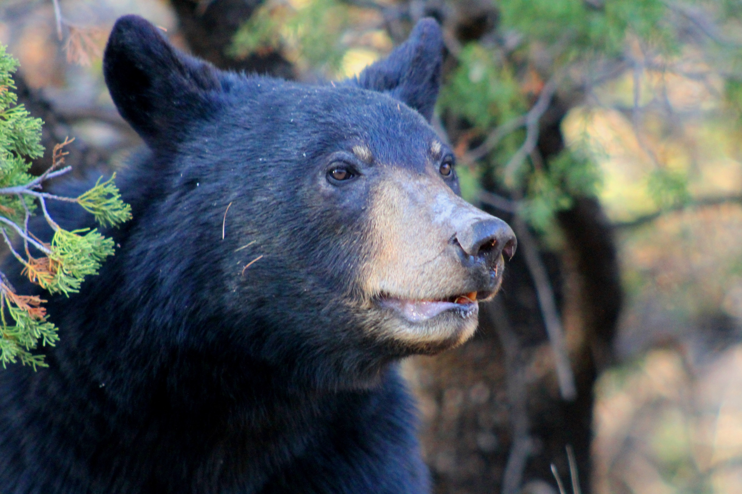

Slide 23
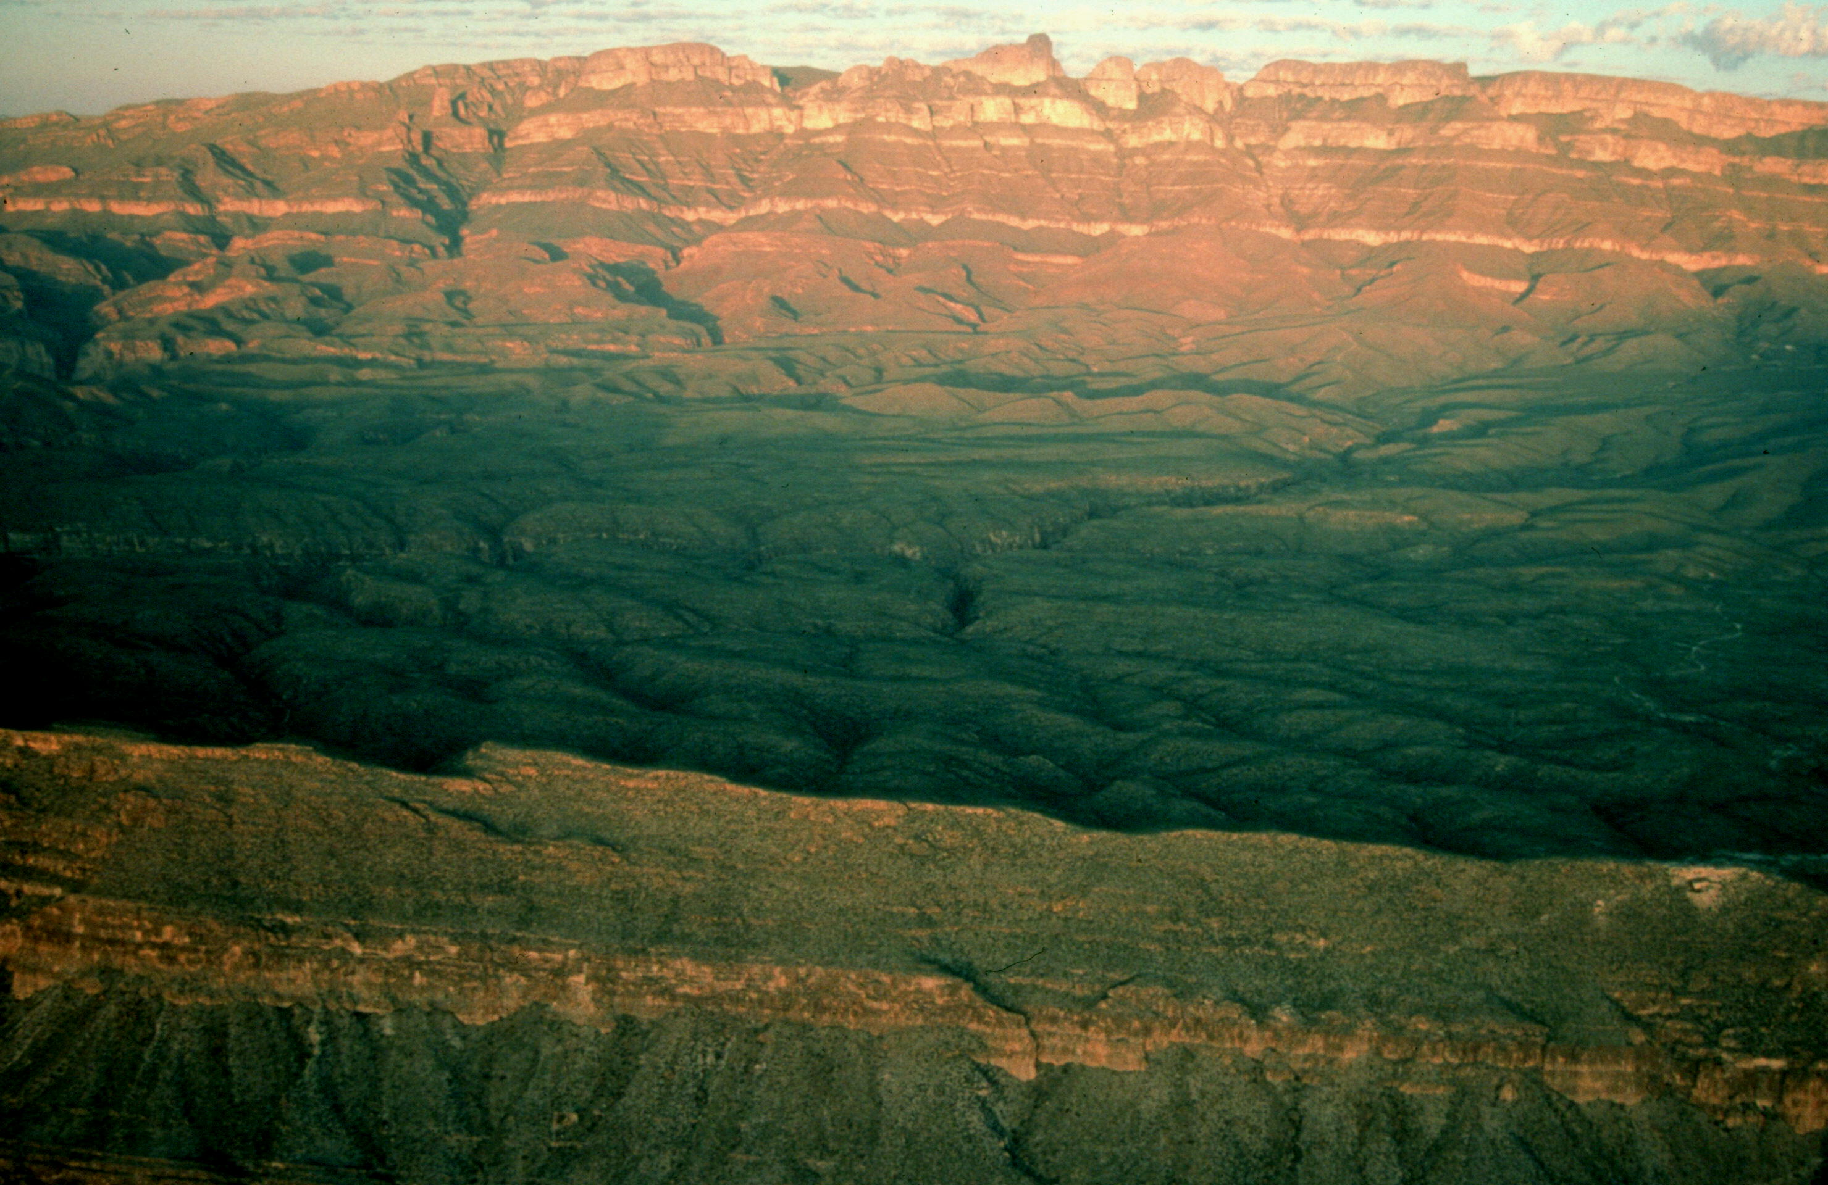
A Dream for Two Nations The United States and Mexico

Slide 24
“I do not believe that this undertaking in the Big Bend will be complete until the entire park area in this region on both sides of the Rio Grande forms one great international park.” President Roosevelt, October 24, 1944

Slide 25
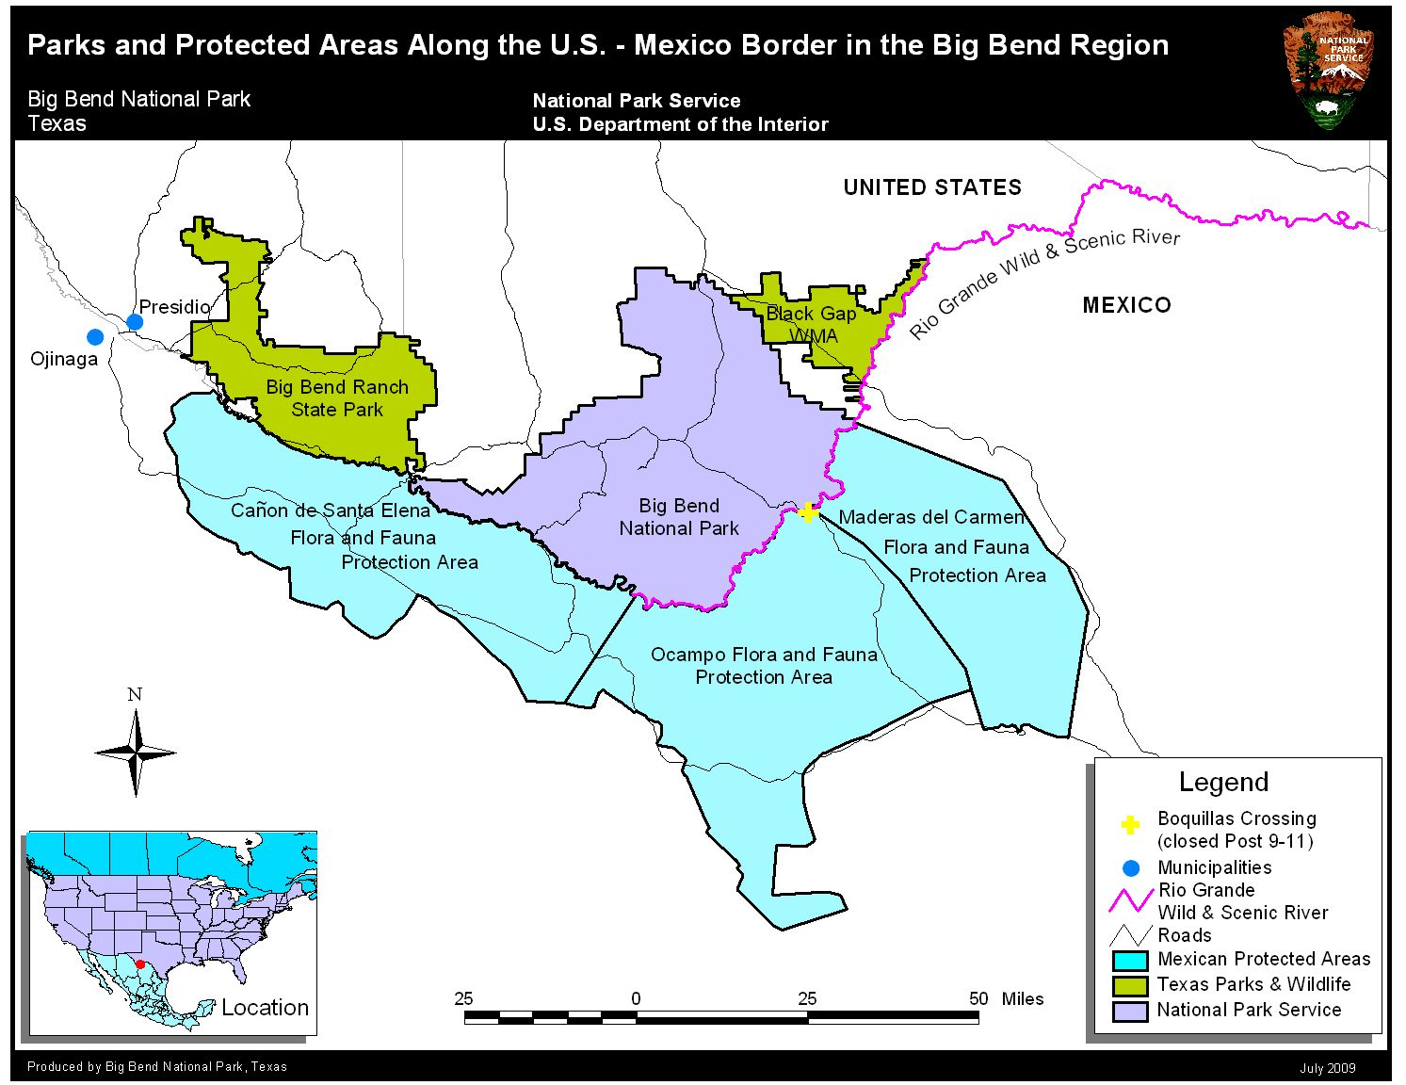

Slide 26
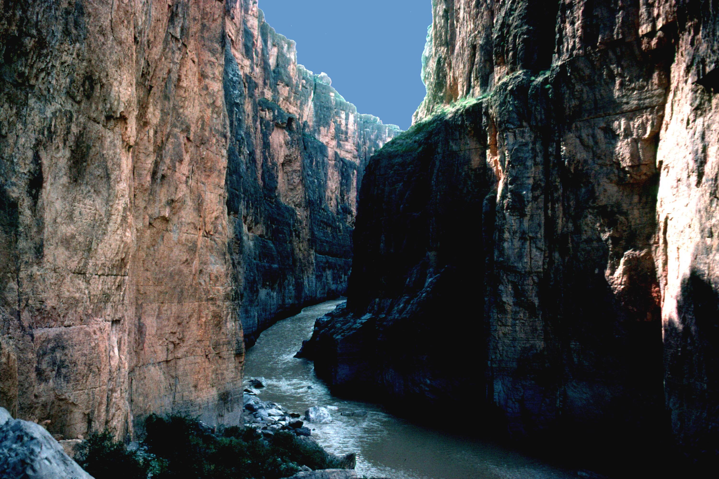
When will the dream
come true?

Slide 27
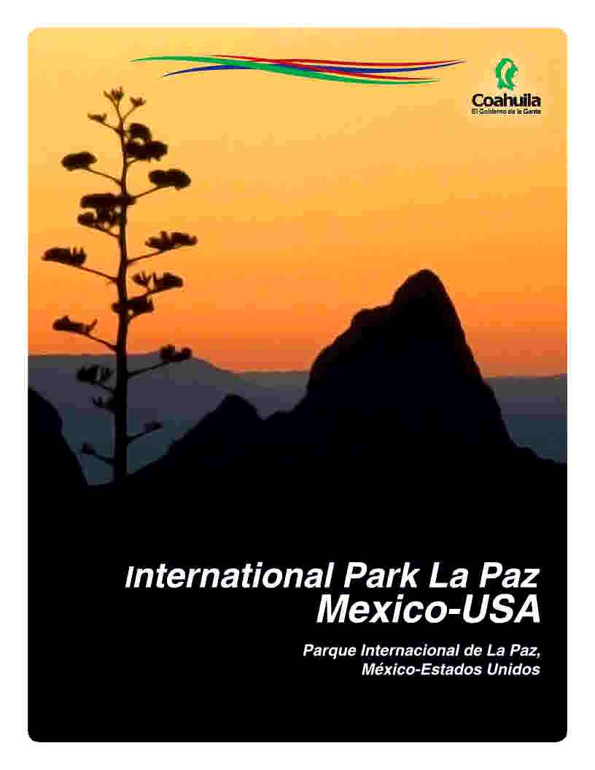

Slide 28
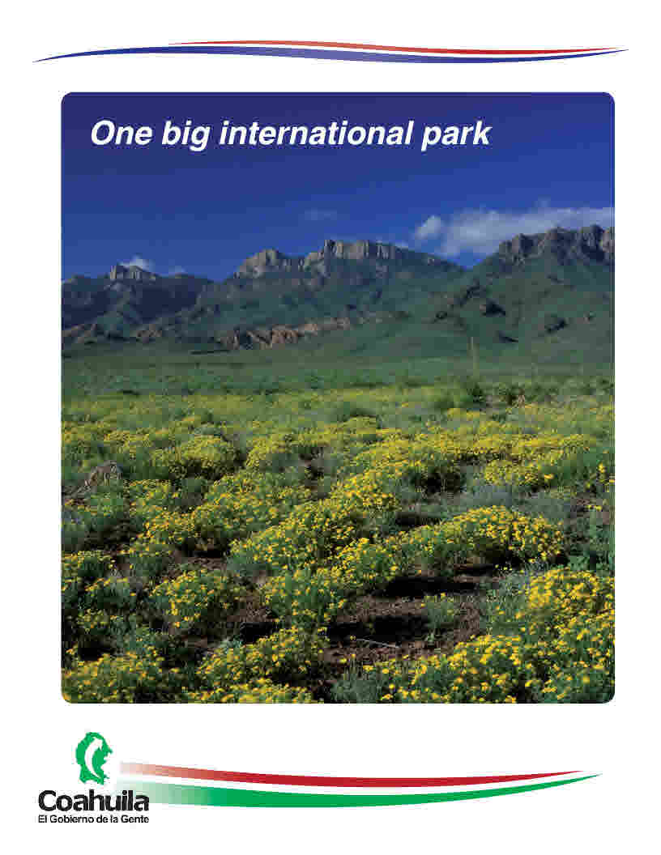

Slide 29
Benefits
Help call attention to the importance of collaboratively protecting the entire Big Bend and adjoining areas in Coahuila and Chihuahua and their fragile environments from development projects. Protecting this fragile desert mountain region and its wildlife and culture is important to the quality of life of people who live there and to ecotourism which is important to the economy of both countries.

Slide 30
Benefits
An international designation would be an example of how our governments and citizens can pursue through cooperation and collaboration a great humanitarian project that celebrates the border region and helps both countries improve their perceptions of what a border is and what a border can be.

Slide 31
Benefits
An international designation would help both countries better address key issues such as water and air quality, control of invasive species, wildlife protection and management of wildland fire.

Slide 32
Benefits
The area would become a permanent monument and symbol of peace between the U.S. and Mexico, one that will celebrate the friendship between the two countries and be a meeting ground where the people of both countries and citizens from all parts of the world could come together to learn about each other’s culture while coming to better understand the natural world that they all share.

Slide 33
Benefits
Preserving desert habitats helps to slow climate change. Desert plants are some of the longest living organisms on the planet and provide substantial carbon sequestration capabilities.

Slide 34
Benefits
Border Wall – Many believe that the need for a border wall is an indicator of failed immigration policies. If we had a better relationship with Mexico we could have more opportunities to collaborate on all of the issues above including immigration challenges and have less of a need for border walls.

Slide 35
Benefits
The key to solving problems every where including the US Mexico border is relationships. People need to come together and get to know each other and a transboundary protected area would help to create important opportunities for that to happen and hopefully encourage transboundary cooperation everywhere along the border.

Slide 36
Questions

